Slide 1
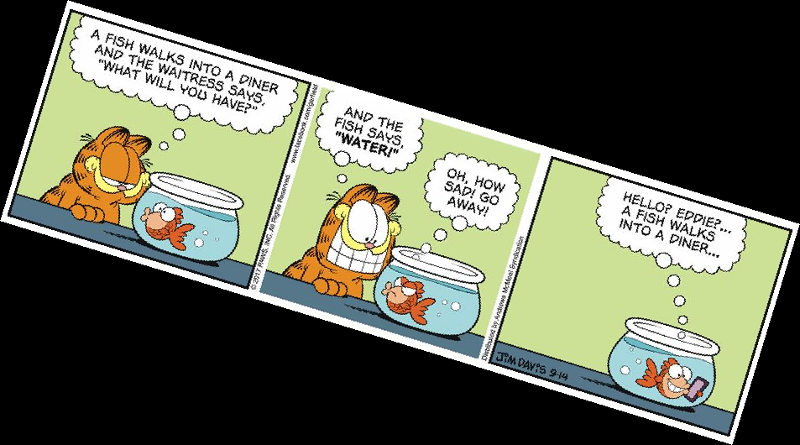
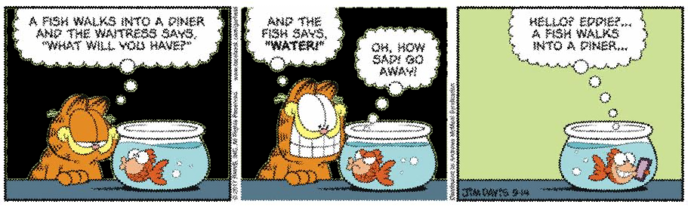
Problem and Goal
Re-orientate comic and blacken the background in all instances where Garfield is present while retaining foreground elements such that the comic remains readable.

Slide 2
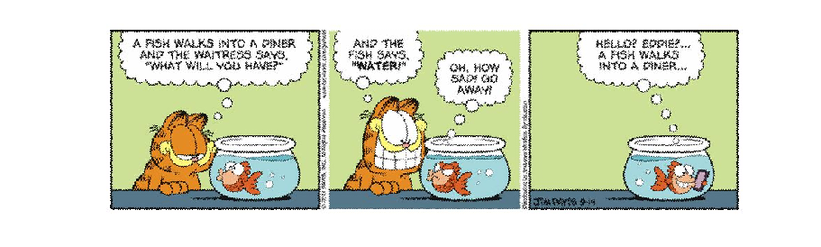
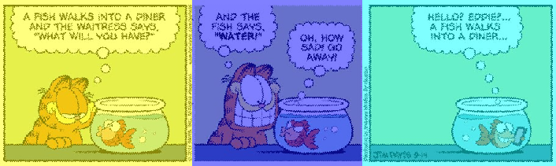
Key Stages
Blacken Background
Re-Orientate Comic
True
True
False
Find Frames
Detect Garfield

Slide 3
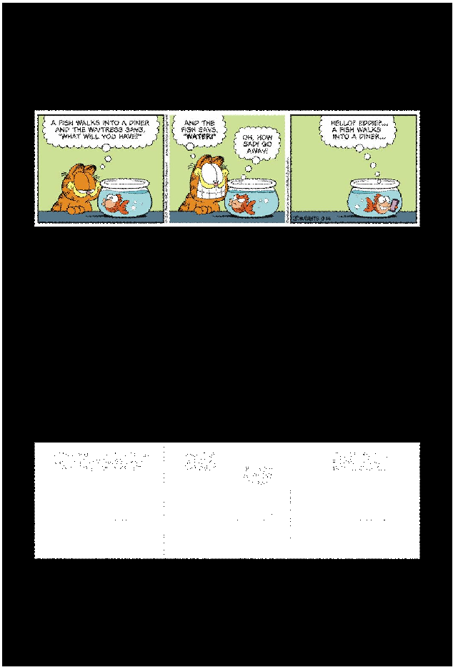

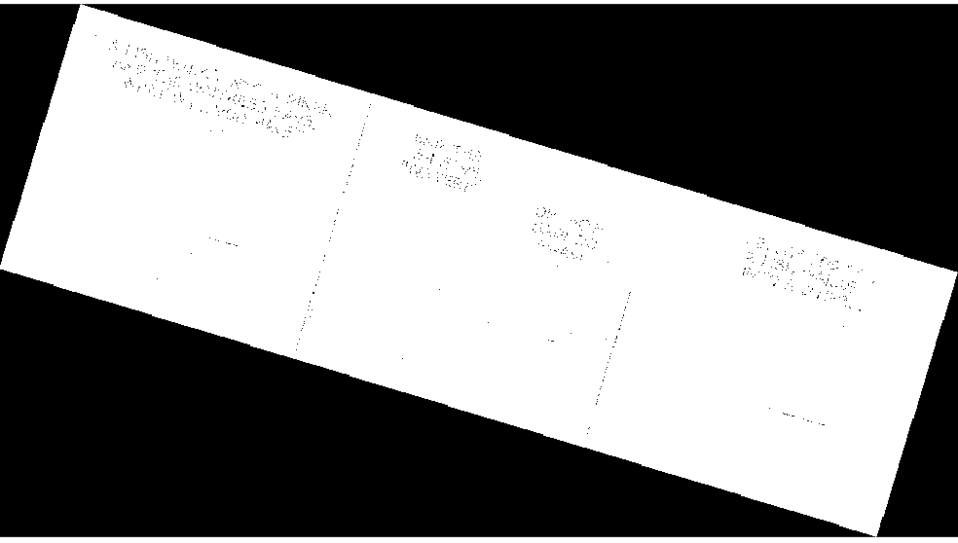
Re-Orientate Comic
BoundingBox
Crop
Threshold
Label Region
Major Axis
Angle
α
Rotate
Open
Close

Slide 4
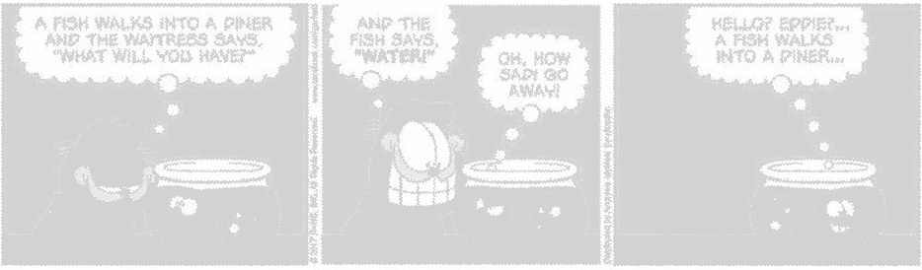
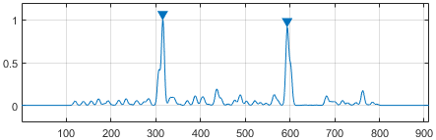
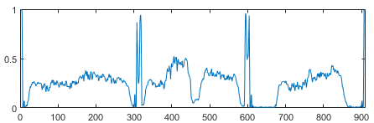
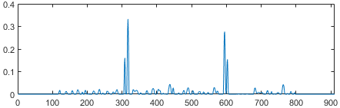
Find Frames
Threshold
Define frame edges
Column-wise mean
Convolution by Gaussian
Label peaks
Convolution by Laplacian of Gaussian
Invert
Truncate

Slide 5

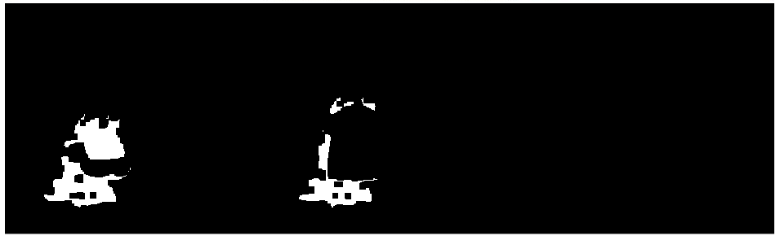
Detect Garfield
True
True
False
Detect Garfield Orange
Detect pixel
Close
Erode
(remove spurious false positives)

Slide 6
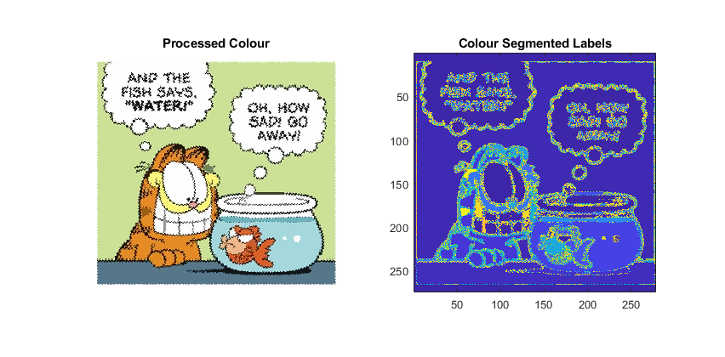
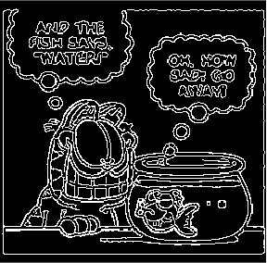
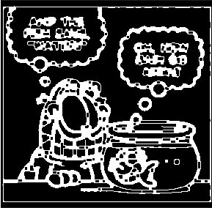
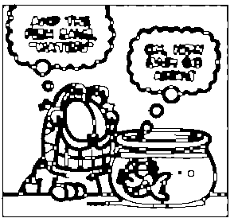
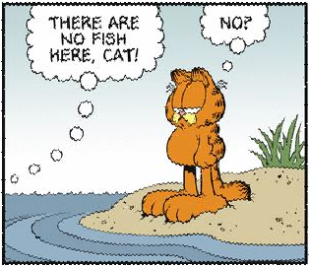
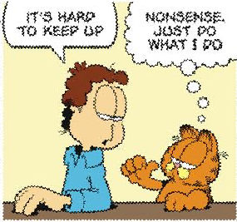
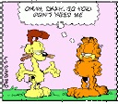
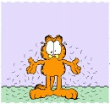
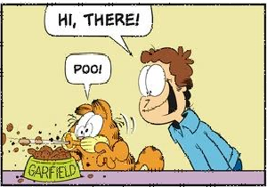
Blacken Background - I
Support colour segmentation:
improving definition of regions
reducing colour variation within regions.
Canny edge detection
Set each region to median colour
Draw border
Close (fill breaks in edges)
Complement
Label 4-connected components
Variable colours in background
Frames with and without borders
Colour artefacts due to poor image quality
Clutter
Foreground similar colour as background

Slide 7
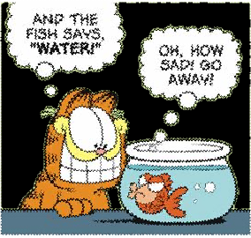


Blacken Background - II
K-Means Clustering on colour
Label colour segments
Apply to colour image
ID largest colour segment or largest region (not white)
Set as background
Aggregate regions of similar colour
Complement
Erode (for soft boundary)
Label 4-connected components
Remove spurious elements

Slide 8
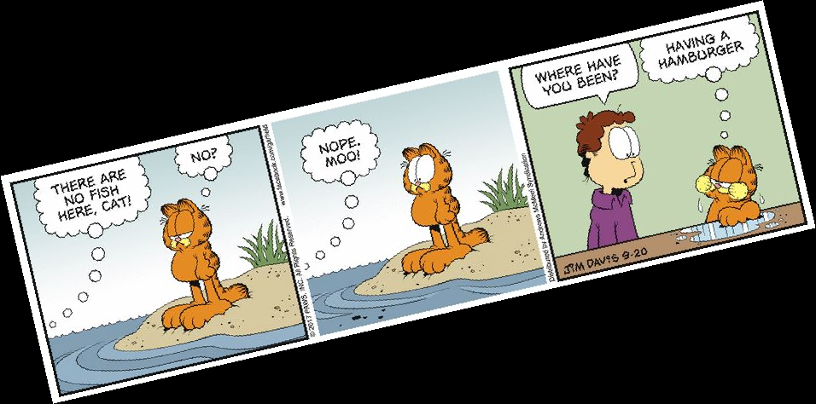
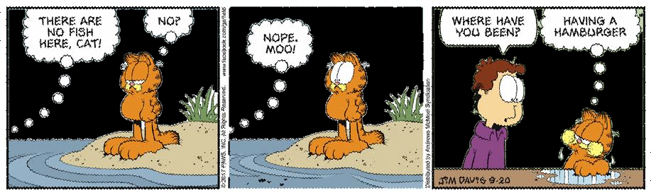
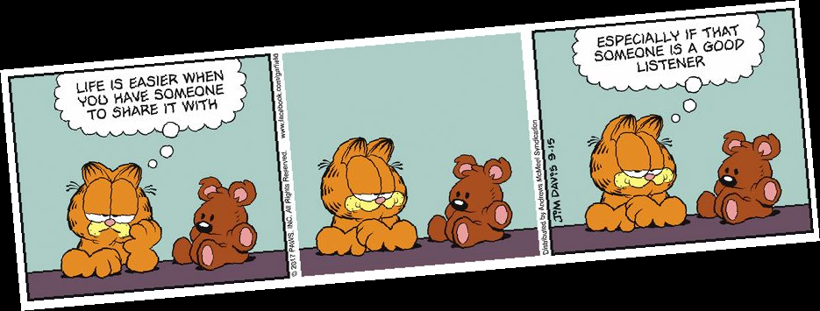
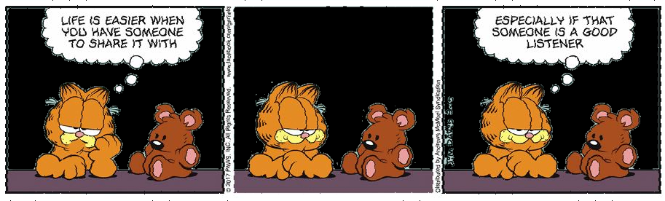
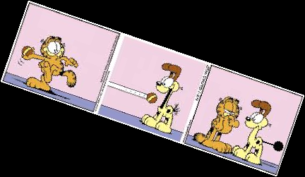
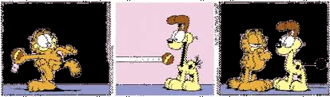
Results
Training Set: 15 / 15
Test Set: 10 / 10
Validation Set: 12 / 15

Slide 9
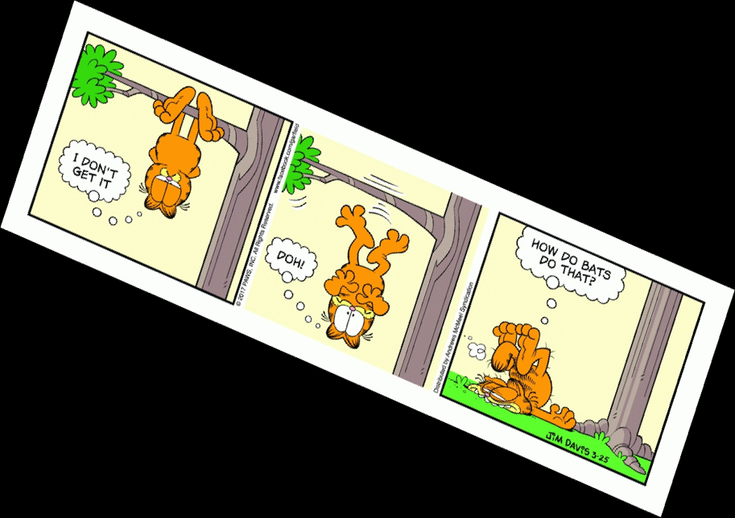
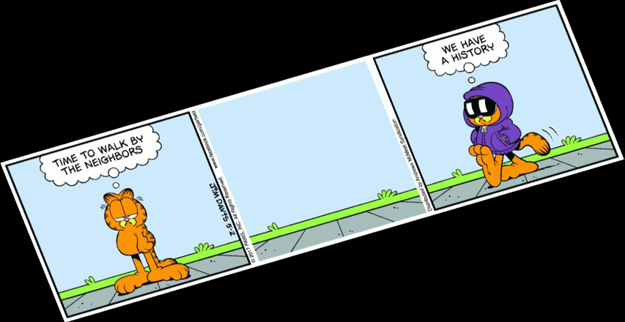
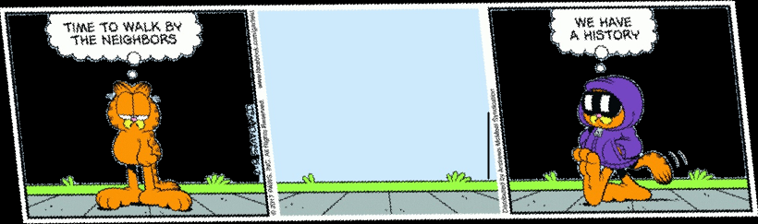
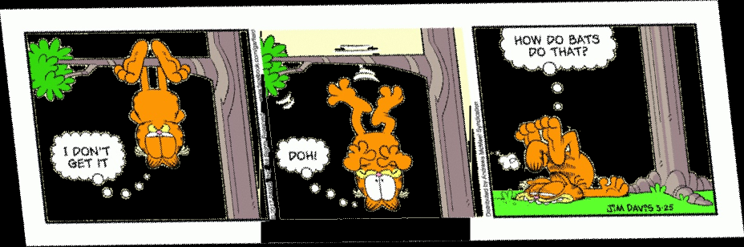
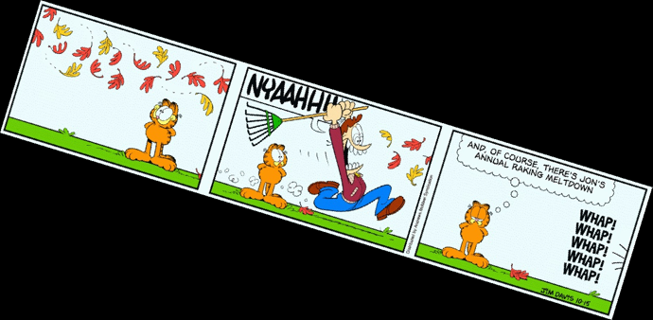
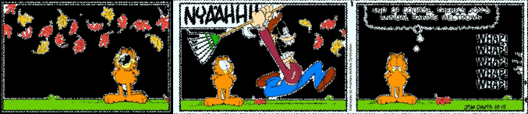
Results
Training Set: 15 / 15
Test Set: 10 / 10
Validation Set: 12 / 15
Original comic is skewed (unanticipated feature)
Affects Re-orientation and Blacken Background I
Background and foreground same colour – almost white
Affects Blacken Background II

Slide 10
